Slide 1
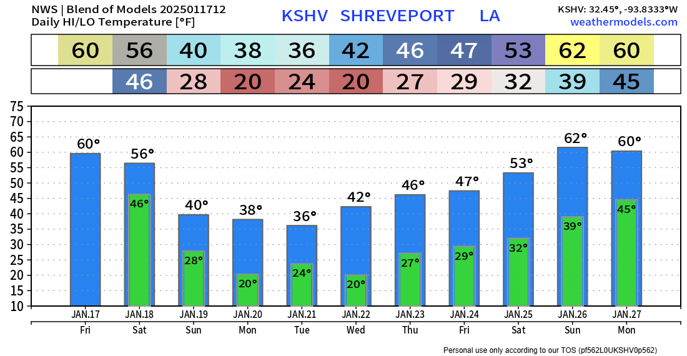

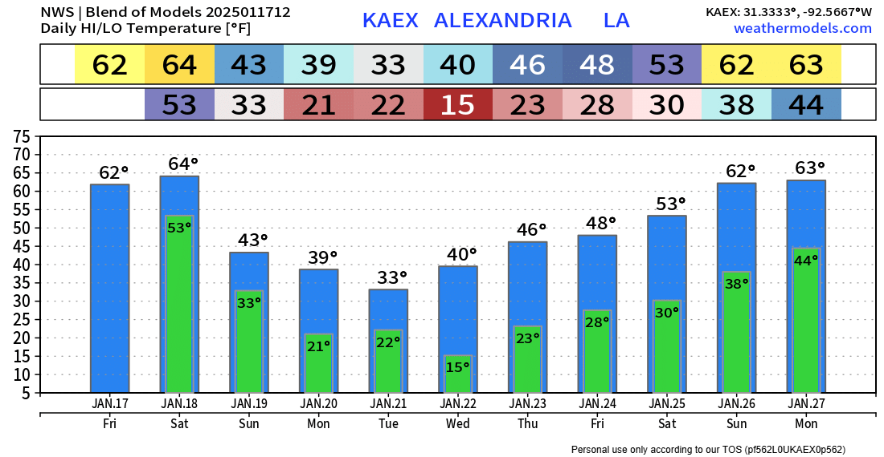
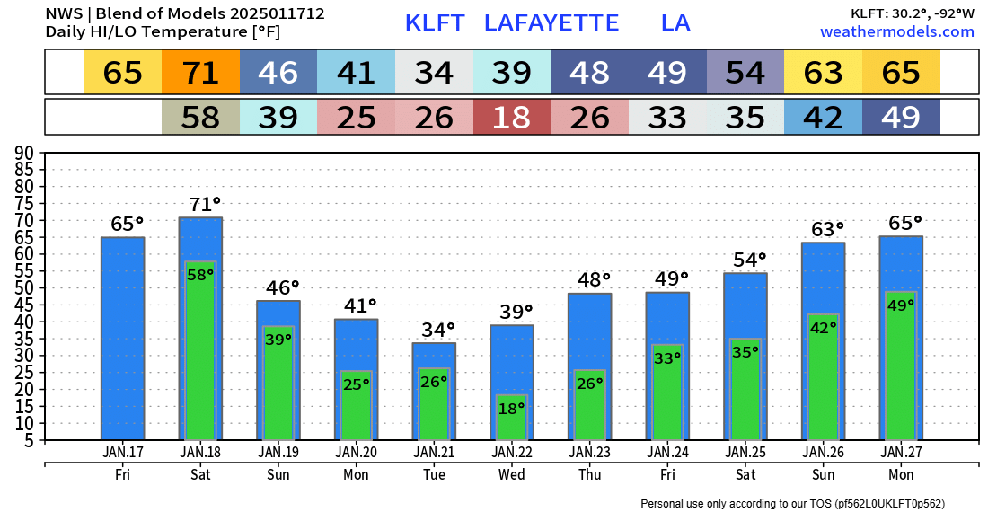

Slide 2
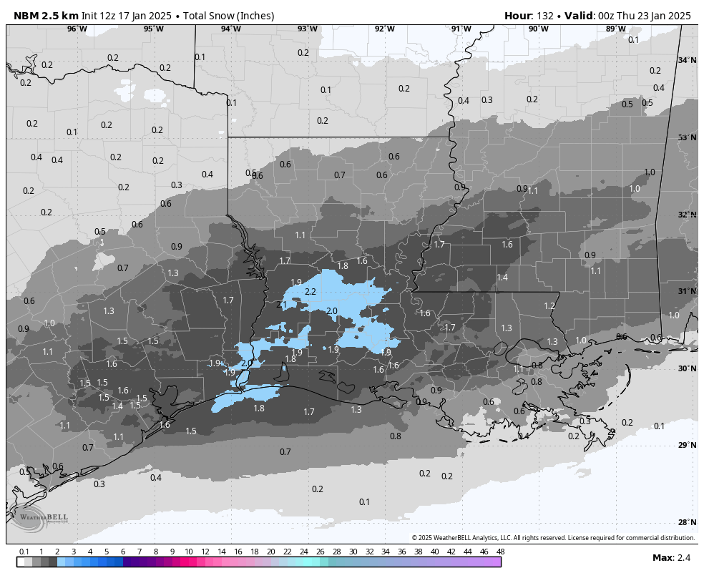
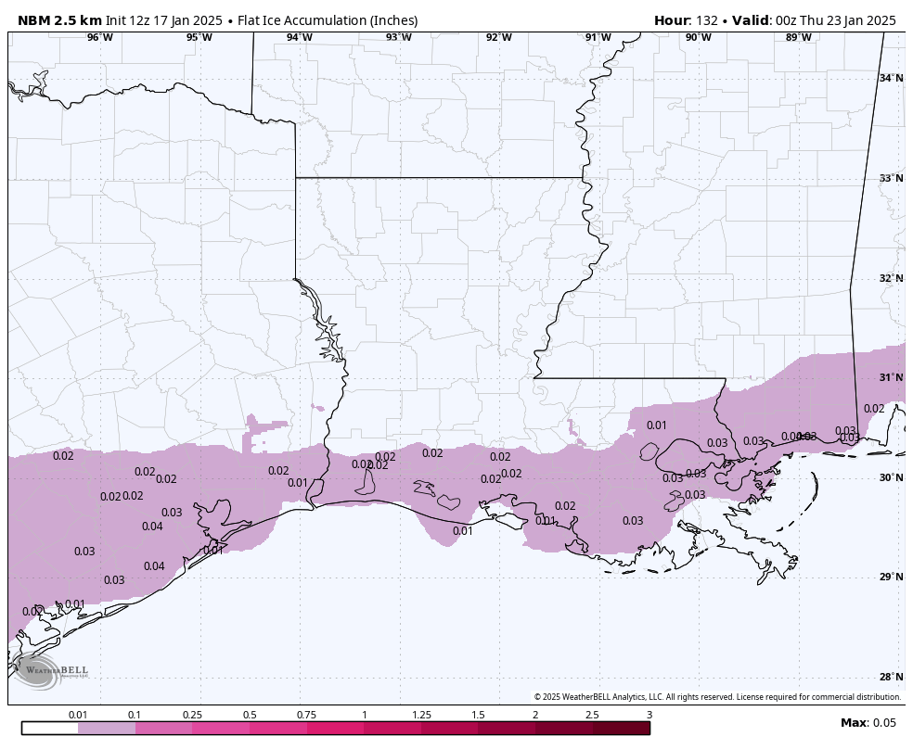
National Blend of Models (NBM)
Not an official forecast … “an “averaging” of multiple models
NBM “model blend”
Dark Gray: 1” - 2”
Light Blue: 2”+
NBM “model blend”
limited icing threat …
Most precip as snow

